Slide 1

Problems based on Trains
Placement Preparation
Aptitude & Reasoning
Prof. Krunal D. Vyas
Computer Engineering Department
krunal.vyas@darshan.ac.in
9601901005

Slide 2
Introduction
This type of question is totally based on concept of time, distance & speed.
Mainly problems based on trains have two objects
Object 1: Those objects who cross another object is considered as object 1, e.g. train, bus, person, etc.
Object 2: Those objects who are crossed by object 1, e.g. train, platform, over bridge, tunnel, person, pole, tree, wall, etc.
Concept of speed:
When both objects are moving in same direction. In this case relative speed is difference between speed of both objects i.e. relative speed = S₁ – S₂.
When both objects are moving in opposite direction. In this case relative speed is sum of speed of both objects i.e. relative speed = S₁ + S₂.

Slide 3
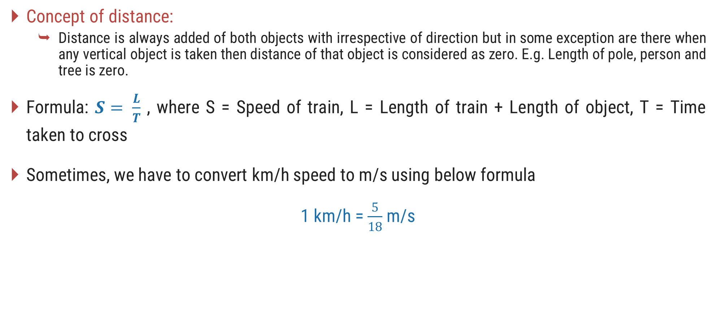
Introduction
Concept of distance:
Distance is always added of both objects with irrespective of direction but in some exception are there when any vertical object is taken then distance of that object is considered as zero. E.g. Length of pole, person and tree is zero.
Formula: $S= \frac{L}{T}$ , where S = Speed of train, L = Length of train + Length of object, T = Time taken to cross
Sometimes, we have to convert km/h speed to m/s using below formula
1 km/h = $\frac{5}{18}$ m/s

Slide 4

When a moving train crosses a standing person
Example: Find the time taken by a train 150m long, running at 54 km/h in crossing an electrical pole
S $=54 km/h=54 X\frac{5}{18}m/s=15 m/s$
L $=150 m+0 m=150 m$
$$S=\frac{L}{T}$$
$$\frac{15m}{s}=\frac{150m}{T}$$
$$T=\frac{150ms}{15m}$$
$$T=10 s$$

Slide 5

When a moving train crosses a moving person in the same direction
Example: A train 180m long is running at a speed of 65 km/h. In what time will it pass a man who is running at a speed of 5 km/h in the same direction?
S $=65km/h−5km/h =60km/h$
L $=180 m+0 m=180 m$
$$S=\frac{L}{T}$$
$$\frac{60 X 5 m}{18 s}=\frac{180m}{T}$$
$$T=\frac{180 X 18 ms}{60 X 5 m}$$
$$T=10.8 s$$

Slide 6

When a moving train crosses a moving person in the opposite direction
Example: A train 150m long is running at a speed of 85 km/h. It will cross a man coming from the opposite direction at a speed of 5 km/h.
S $=85km/h+5km/h =90km/h$
L $=150 m+0 m=150 m$
$$S=\frac{L}{T}$$
$$\frac{90 X 5 m}{18 s}=\frac{150m}{T}$$
$$T=\frac{150 X 18 ms}{90 X 5 m}$$
$$T=6 s$$

Slide 7

When a moving train crosses a platform
Example: A train 140m long is running at a speed of 60km/h. In how much time will it pass a platform 260m long?
S $=60km/h$
L $=140 m+260 m=400 m$
$$S=\frac{L}{T}$$
$$\frac{60 X 5 m}{18 s}=\frac{400m}{T}$$
$$T=\frac{400 X 18 ms}{60 X 5 m}$$
$$T=24 s$$

Slide 8

When a moving train crosses another stationary train
Example: A train 180m long takes 20 sec in crossing a stationary train 220m long. The speed of the train is?
T $=20 s$
L $=180 m+220 m=400$
$$S=\frac{L}{T}$$
$$\frac{S X 5 m}{18 s}=\frac{400m}{20 s}$$
$$S=\frac{400 X 18 ms}{20 X 5 m}$$
$$S=72 km/h$$

Slide 9

When a moving train crosses another moving train along same direction
Example: Two trains travelling in the same direction at 54 km/h and 36 km/h completely pass one another in 1 minute. If the length of the first train is 125 meters, the length of the second train is?
S $=54 km/h −36 km/h =18 km/h$
T $=1 m=60 s$
$$S=\frac{L}{T}$$
$$\frac{18 X 5 m}{18 s}=\frac{L}{60 s}$$
$$L=\frac{18 X 5 X 60 ms}{18 s}$$
$$L=300 m$$
L $=300 m=125 m +x, x=300m−125m=175m$

Slide 10

When a moving train crosses another moving train coming from opposite direction
Example: Two trains are running in opposite direction with the same speed. If the length of each train is 120 meters and they cross each other in 12 seconds, the speed of each train is?
T $=12 s$
L $=120 m+120 m=240 m$
$$S=\frac{L}{T}$$
$$\frac{S X 5 m}{18 s}=\frac{240m}{12 s}$$
$$S=\frac{240 X 18 ms}{12 X 5 m}$$
$S=72 km/h$, hence speed of each train is $36 km/h$

Slide 11

When a moving train crosses a person sitting in another train (both direction)
Example: A goods train 150 m long moving with speed 54 km/h. A man is sitting in a passenger train which is moving with 18 km/h in same direction. In how many seconds the goods train crosses the man sitting in a passenger train?
S $=54 km/h −18 km/h =36 km/h$
L $=150 m+0 m=150 m$
$$S=\frac{L}{T}$$
$$\frac{36 X 5 m}{18 s}=\frac{150m}{T}$$
$$T=\frac{150 X 18 ms}{36 X 5 m}$$
$$T=15 s$$

Slide 12


When a moving train crosses two different objects
Example: A train running at a speed of 30 km/h takes 18 sec to pass a railway platform and it takes 15 sec to pass a man who is running at a speed of 6 km/h in the same direction. Find the length of platform?
Here, we have two different cases.
First case is of train and man
S $=30 km/h −6 km/h =24 km/h$
T $=15 s$
$$S=\frac{L}{T}$$
$$\frac{24 X 5 m}{18 s}=\frac{L}{15 s}$$
$$L=\frac{24 X 15 X 5 ms}{18 s}$$
$$L=100 m$$
Second case is of train and platform
S $=30 km/h$
T $=18 s,$L $=100 m+length of platform=100+x$
$$S=\frac{L}{T}$$
$$\frac{30 X 5 m}{18 s}=\frac{100+x}{18 s}$$
$$100+x=\frac{30 X 18 X 5 ms}{18 s}$$
$$x=150 m−100 m=50 m$$

